Slide 1
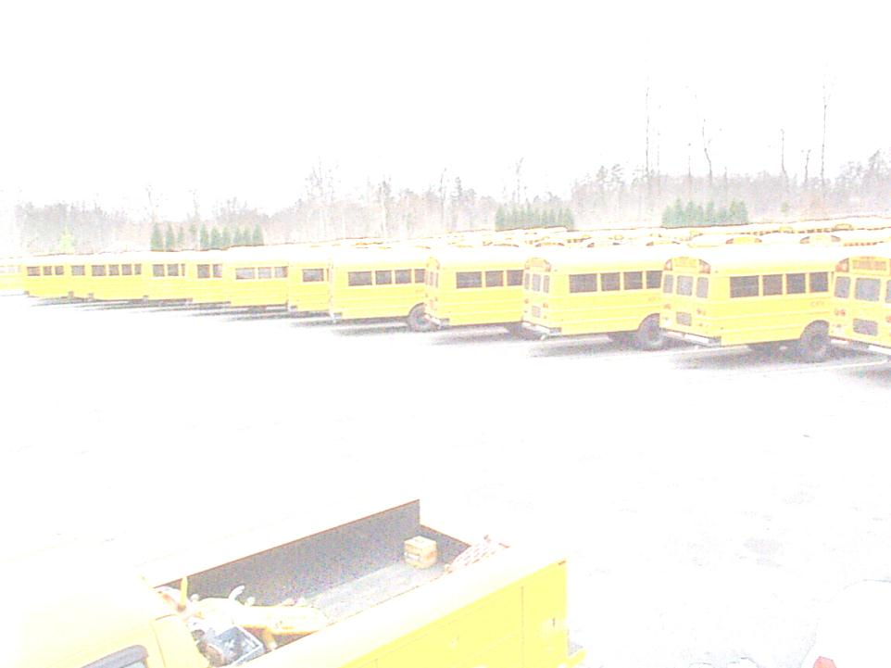

DEFECTS found during 2015-2016 annual school bus inspections

Slide 2
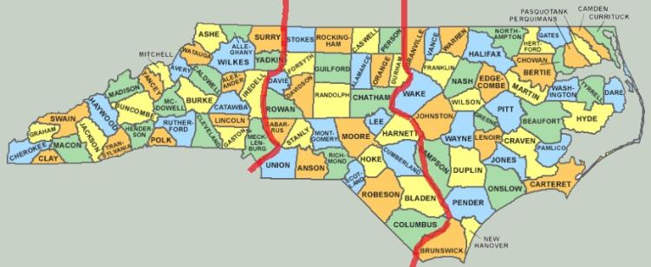



NCDPI FIELD TRANSPORTATION CONSULTANTS
Randy Henson
Robert Taylor
Keith Whitley
Employed by N.C. Department of Public Instruction

Slide 3

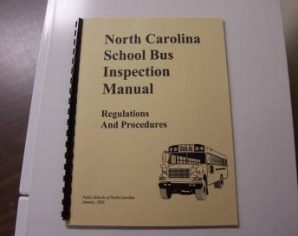
State inspectors check 10% of the fleet each year. (October-June)
The inspection is based on rules in the NC 30 Day Inspection Manual developed by committee consisting of Transportation Directors, Shop Foremen, Bus Inspectors, Bus Technicians.
A total of 6221 defects were written
up by the three field consultants.
A total of 1697 buses were inspected.

Slide 4

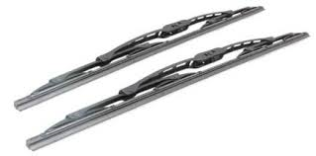
Replace wiper blades
68 times
5 pts

Slide 5

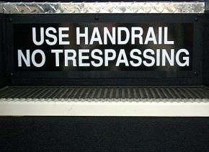
74 times
1)Entrance step lettering damaged- 2 pts

Slide 6

Repair marker lights
75 times 5 pts.

Slide 7

Entrance door Access panel damaged
77 times
2 points

Slide 8


One note horn-
82 occurrences 10 pts

Slide 9
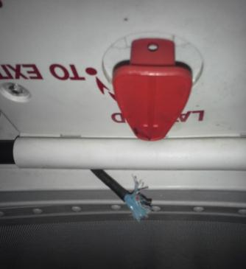

Window/Roof hatch buzzers
Inoperable-96
5 pts.

Slide 10

Engine oil leaks
118 found
10 pts.

Slide 11

Repair brake lights (1-3 bulbs)
121 occurrences
5-15 pts.

Slide 12

Dirty Bus
139 times. 5 pts.

Slide 13
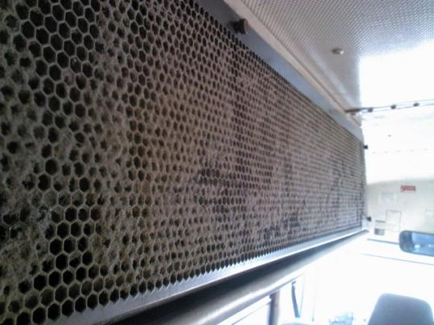

A/C filter loose or dirty-
150 found 5 pts.

Slide 14
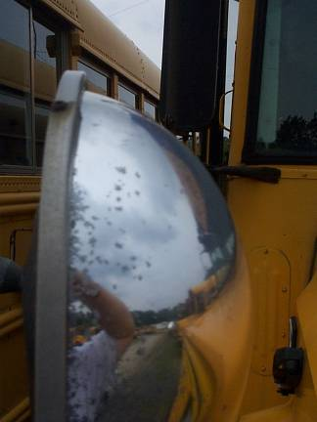

172 found
5 pts.
Crossover mirrors not
Adjusted per FMVSS 111

Slide 15

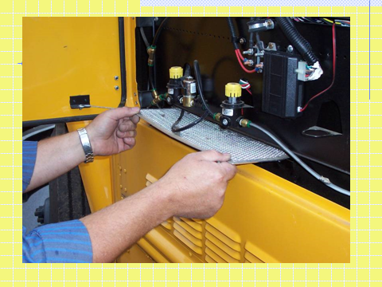
Heater Filter Dirty-199 occurrences
5 pts.

Slide 16

Loose seat bottoms
211 found
5 pts.

Slide 17

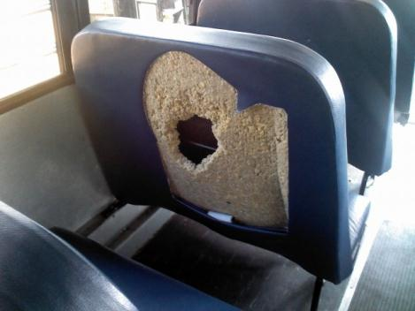
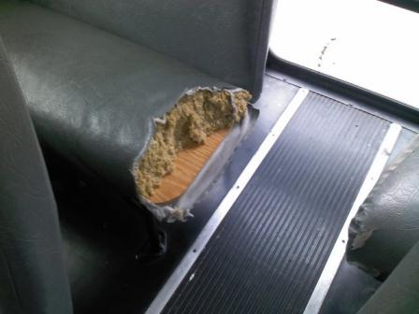
Seat Cushion and Foam damage-
218 occurrences 5-10 pts.

Slide 18
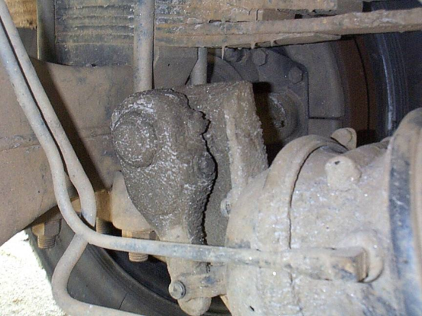

Slacks need cleaning-243
5 pts.

Slide 19
QUESTIONS ?
OR COMMENTS.

